Slide 1

Adding overlap brackets

Slide 2
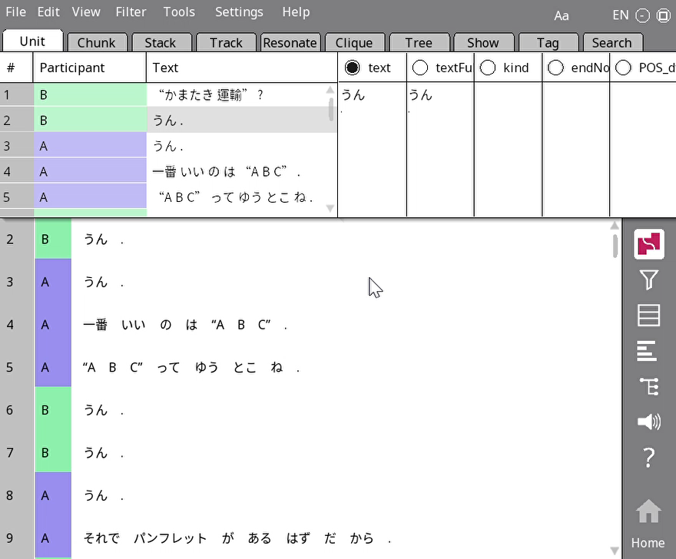
How
Make sure you are in one-to-many mode
Right-click on the token
Click ‘Sync to unit tab’
Double-click on the cell under the right column – textFull for Japanese, Col_4 for Spanish
Add the bracket

Slide 3
Special notes
If there are multiple overlap events in the same/adjacent lines, make sure to use numbering ([ ] then [2 2] and so on)
If the opening and closing bracket are on the same line, you can leave the number out from the second one ([2 ])
Once you get to 9, you have to go back to 1. Don’t give us second-digit numbers.

